Slide 1

Ana Muslim Sdn Bhd
Project: Production Tracking
To develop a web based and mobile application that can be used by the company to track near real-time progress of printing process from pre-press until delivery of finished goods.
MOHD ASYRAF OTHMAN
SEPTEMBER - DECEMBER 2023
COO
Target Deployment: Q1 2024

Slide 2

ANA MUSLIM
Existing Problems/ Challenges
Lack of Real-Time Visibility:
Problem
Statement
01
The current system lacks real-time tracking capabilities, making it difficult to monitor progress and address issues promptly.
Manual Data Entry and Tracking:
02
The process heavily relies on manual data entry, leading to errors, delays, and a lack of accuracy in tracking.
Currently, our printing process involves multiple stages from pre-press preparation to final delivery. However, this process faces several challenges that impact efficiency and accountability.
Inefficiencies in Communication:
03
Communication gaps between teams handling different stages of printing often lead to misunderstandings and delays.

Slide 3

Ana Muslim
Objectives
By addressing existing challenges and establishing clear objectives, the Printing Process Tracking Application will play a pivotal role in revolutionizing our printing operations.
Streamline and Enhance Tracking
01
The primary objective of developing the Printing Process Tracking Application is to streamline and enhance the tracking process from pre-press to final delivery.
Enhance Accountability
03
The application will introduce clear role assignments and tracking mechanisms, ensuring accountability at every stage of the printing process.
Provide Real-time Insights:
Improve Operational Efficiency:
04
One of the key benefits of the application will be the provision of real-time data and insights. This will empower our team to make informed decisions promptly, leading to improved overall productivity.
02
By implementing this application, we aim to significantly reduce manual intervention, thereby increasing operational efficiency and minimizing the likelihood of errors.

Slide 4





OFFSET PRINTING
PROCESS FLOW
1 - Pre-press
2 - Printing
3 - Post-press
4 - Finishing
5 - Delivery
Pre Press involves all activities before actual printing, including design creation, proofing, plate-making, and material procurement.
Printing is the stage where the designed content is transferred onto paper using ink and printing plates through a press.
Post Press encompasses tasks after printing, such as folding, collating, binding, and other processes to prepare the printed material.
Finishing involves final touches like lamination, coating, quality checks, and packaging to ensure the printed material meets quality standards.
Delivery is the final stage where the finished printed material is transported and handed over to logistics/warehouse arrangements.

Slide 5
1: PRE-PRESS
Design and Layout
Graphic designers create the layout and design of the book, ensuring it meets the project’s specifications.
ISBN Application
An application for an International Standard Book Number (ISBN) is submitted to the relevant authorities. This unique identifier helps in cataloging and distribution.
Digital Proofing
A digital proof is created for printing approval. This allows final checker to review the design, colors, and layout before printing.
Plate Making & Registration
Separate printing plates are created for each color channel. These plates are usually made of aluminum and contain the image areas. The printing plates are aligned accurately to ensure precise color registration during printing.
Material Procurement
The necessary paper and other printing materials are sourced and purchased for the production process.

Slide 6
2: PRINTING
Printing Setup
The printing press is set up with the correct paper type and size. Ink levels and pressure are adjusted.
Inking
The rollers of the press apply ink to the printing plates. Each roller is responsible for one of the four ink colors.
Printing of Cover Page
The cover paper is fed through the press, passing under the rotating cylinders. Each color is applied in succession, creating the final full-color image. Additional finishing steps like lamination, embossing, or other enhancements may be applied to the cover for added visual appeal and durability.
Printing of Content Pages
The paper is fed through the press, passing under the rotating cylinders. Each color is applied in succession, creating the final full-color image.

Slide 7
3: POST-PRESS
Folding
The printed sheets are folded in the correct sequence to create the pages of the book.
Collating
The folded pages are arranged in the correct order to form the book's content.
Binding
In the case of a perfect-bound book, the pages are gathered, and adhesive is applied to the spine. The cover is then wrapped around.
Cutting/Trimming
Excess edges of the book are trimmed to create clean, uniform edges.

Slide 8
4: FINISHING
Optional Packaging
A protective packaging or other finishing material of some sort may be applied to the finish books for added durability or to enhance aesthetics.
Quality Check (Printing)
A final inspection by the printing personnel is conducted to ensure all pages are in the correct order, colors are accurate, and there are no defects.
Packing and Shipping
The finished books are packed and prepared for shipping or delivery to the warehouse/logistics side.

Slide 9
5: DELIVERY
Delivery Logistics
Arrangements are made for the transportation of the finished books to the warehouse.
Acceptance
Warehouse receives and reviews the printed books to ensure they meet their expectations.
Documentation
Invoices are prepared and necessary documentation, including GR, is completed.
Quality Check (Editorial)
final inspection by the editorial personnel is conducted to ensure all pages are in the correct order, colors are accurate, and there are no defects.
Released to Market (RTM)

Slide 10


Critical processes
to build our app flowchart.
1
2
3
4
Design and Layout
ISBN Application
Plate Making
Material Procurement
Printing (Cover)
Printing (Content)
Folding
Binding
Trimming
Packing
Acceptance
QC (Editorial)
RTM
Use sticky notes to add comments. Just copy, paste, and drag them to the flowchart!
You can also color-code them. For instance, red notes can be used to flag bottlenecks!

Slide 11
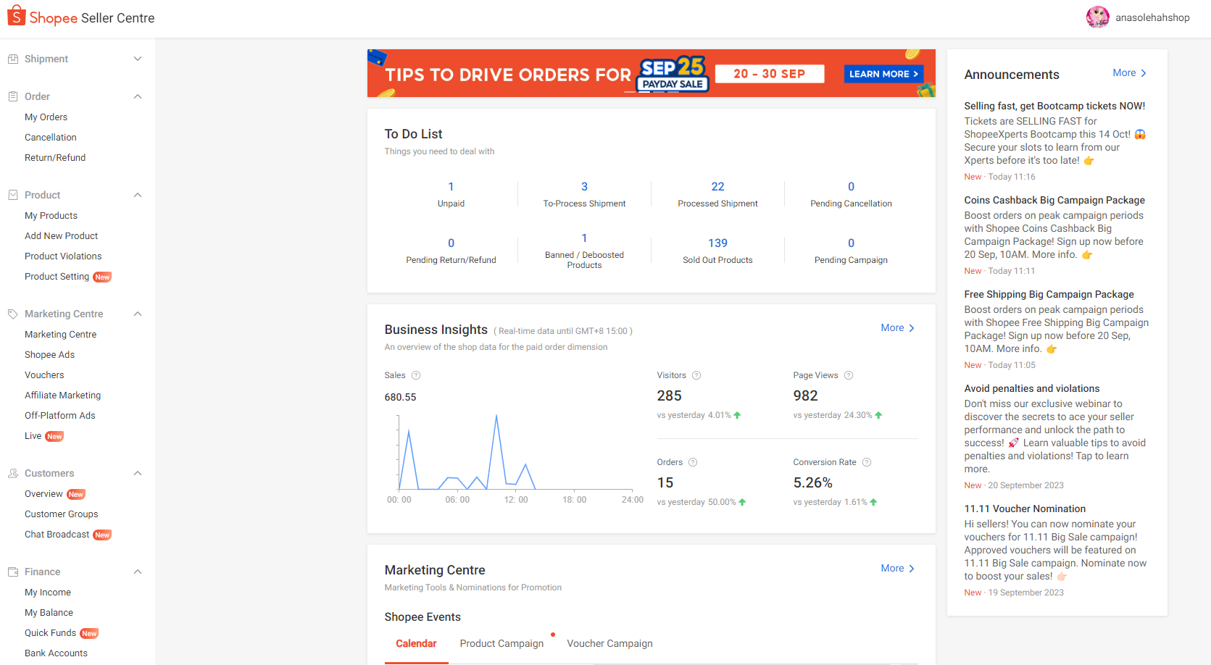
MAIN MENU
ANNOUNCEMENTS
SUB-MENU
ACTIVITY TRACKER
DASHBOARD
(ANALYSIS)

Slide 12
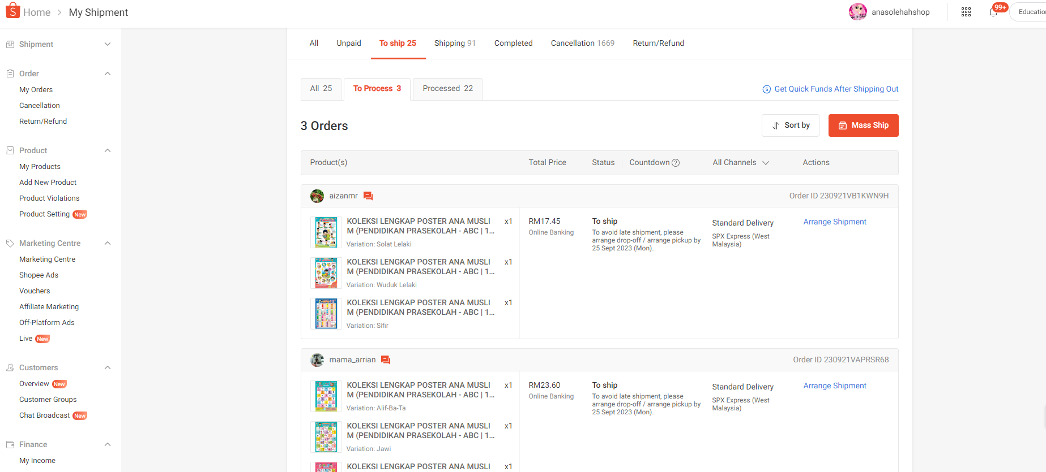

PROCESS TRACKER
TAB BY MAJOR MILESTONES:
PREPRESS, PRINTING, POST PRESS, FINISHING, DELIVERY
TAB BY SUB-PROCESS
STATUS
SLA
ACTION
BOOK PHOTO & INFO

